Slide 1
Hybrid Search Midpoint Presentation
Group A
Chaman Ali | 15016005
Surendra Dura | 15007669
Keith Feeney | 15015556
Chenlei Jie | 01318877
Business Application Development | June 2018
Notes:
Welcome

Slide 2
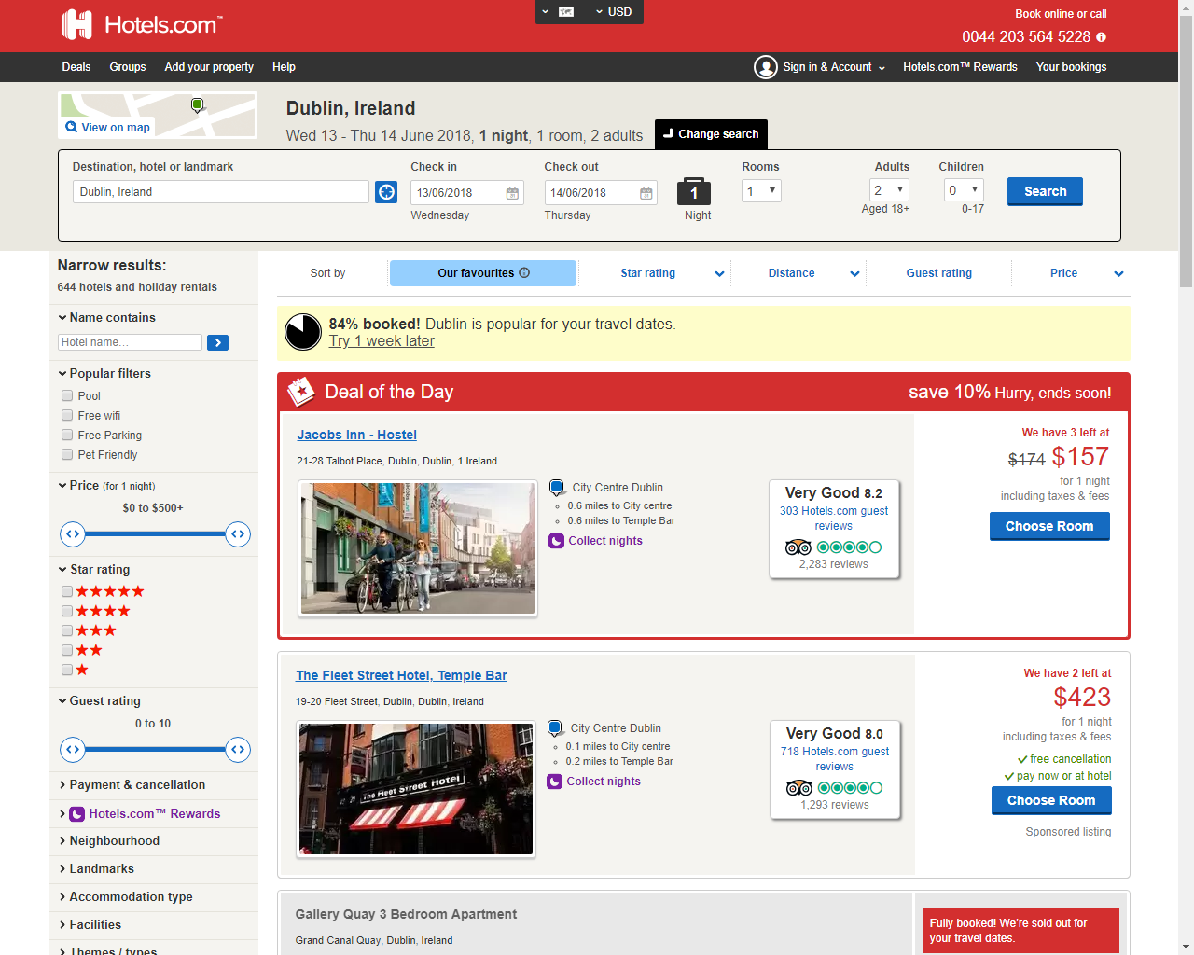
Introduction & Project Background
Meta-searching website
Examples of meta-searching websites:
Hotels.com
Trivago
CheapFlights.com

Slide 3

Introduction & Project Background
For the OAP market
Services will be included:
HSE
Local GP information
Hospital information.
Events will be added.
(Public domain)

